Slide 1
Progres 4 – Inversi Moment tensor (Gradient descent/steepest descent)
Azhar Harisandi - 22320011
Faculty of Mining and Petroleum Engineering
Department of Geophysical Engineering

Slide 3
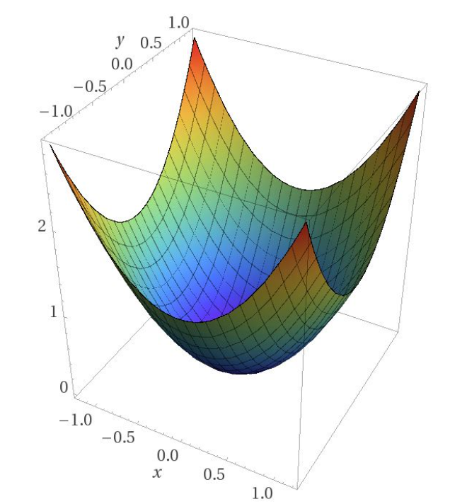
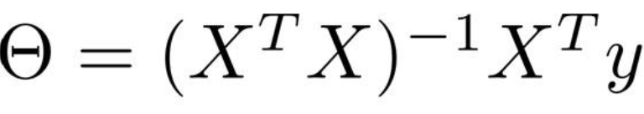
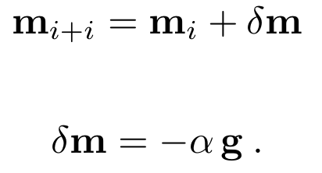
Optimization
Loss/Misfit function surface
Gradient (steepest ascent)
-Gradient (steepest descent)
Linearized inversion

Slide 4
Momen Tensor
Why moment tensor
Adjoint method
NLCG

Slide 5
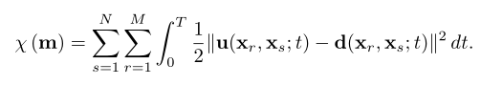
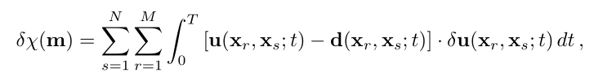
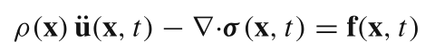
Waveform misfit
Synthetic
waveform
Actual waveform
Gradient of misfit function
density
Elastic modulus
Source
?
displacement

Slide 6
Adjoint simulation

Slide 7
Adjoint method
Way to calculate gradient of misfits function with respect to structural parameters or source parameters
Take misfit variation with respect to structural/source parameters
Adjoint source
Run Adjoint simulation
Gradient of misfit function
Define misfit function

Slide 8
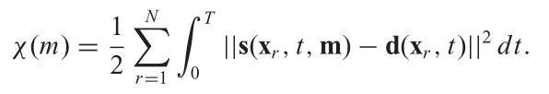
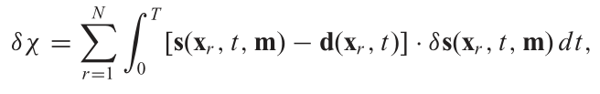
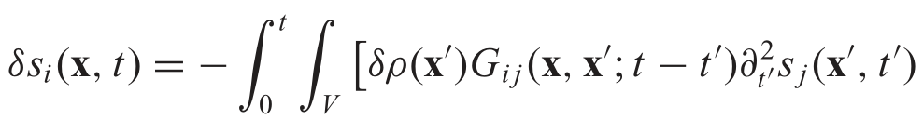
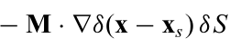
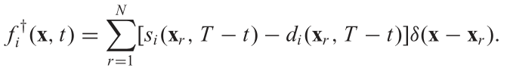
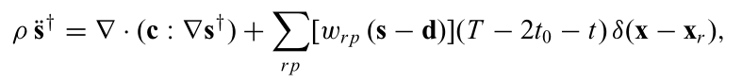
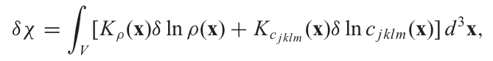
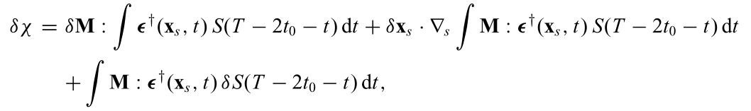
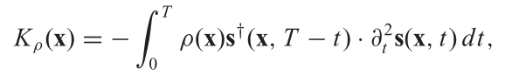
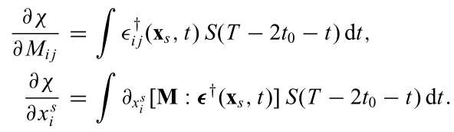
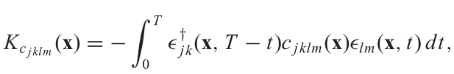
Adjoint method
1
Variation with respect to structural parameter
Variation with respect to source parameter
Adjoint source
Adjoint source
1
1

Slide 9
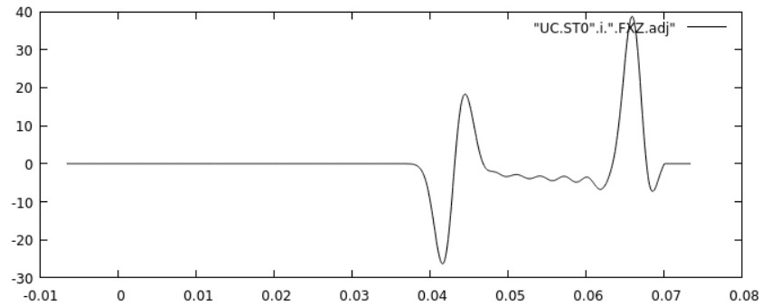
Adjoint simulation in a nutshell
Regular forward simulation
Solve wavefield
regular wavefield
Create seismic source
Adjoint simulation
Create adjoint source
Time-reverse the adjoint source
Solve wavefield (receiver as virtual source)
Adjoint wavefield

Slide 10
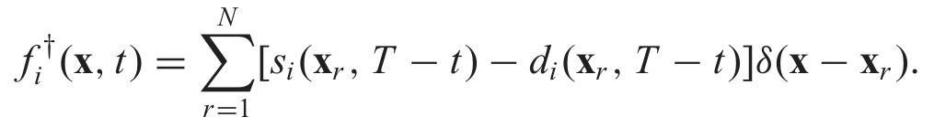
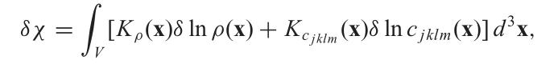
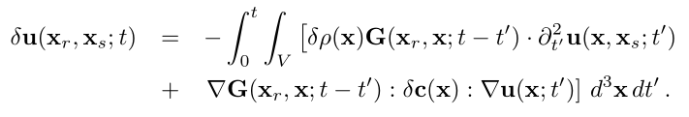
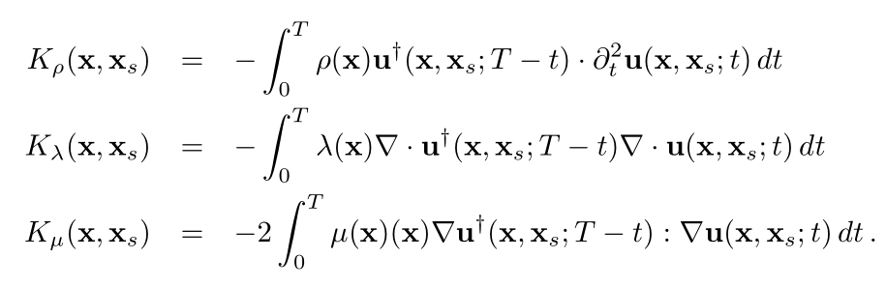
Waveform misfit adjoint source
Adjoint simulation -> tools untuk menghitung gradien dari misfit function

Slide 11
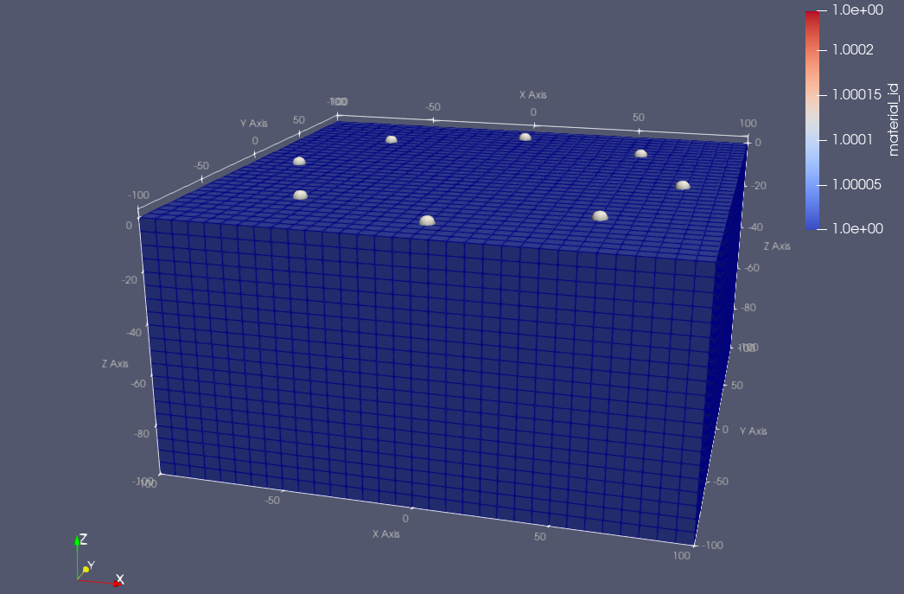
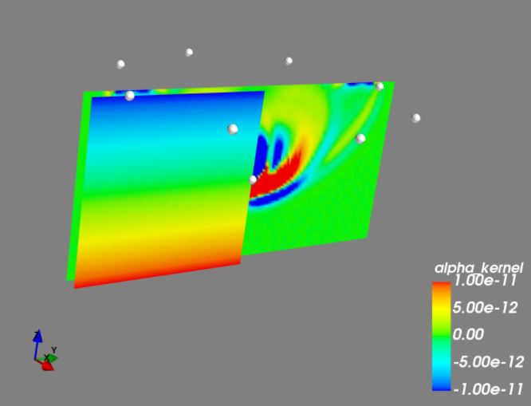
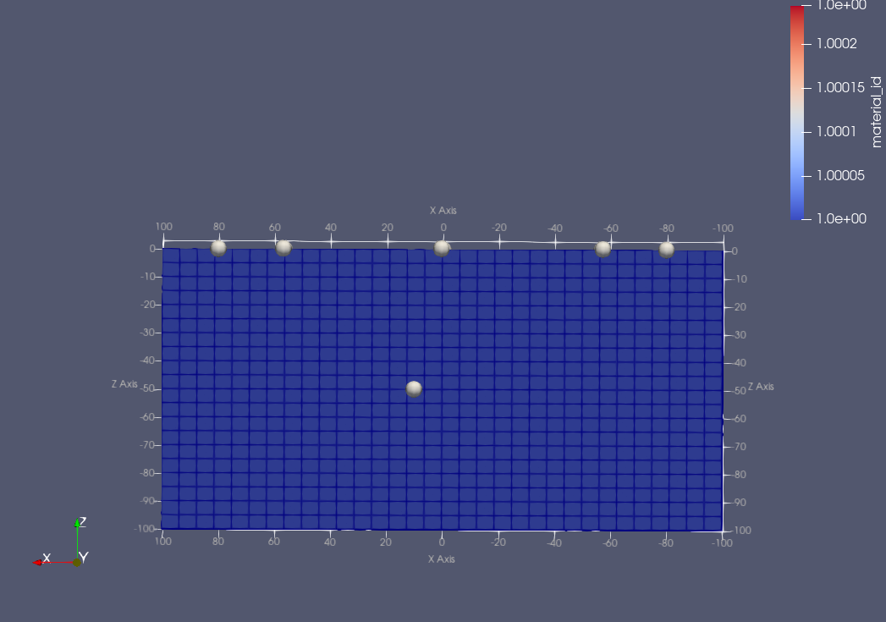
Model configuration (for synthetic and “data”)
Velocity for “DATA”
XMIN, XMAX = -100, 100 (in M)
YMIN, YMAX = -100, 100
ZMIN, ZMAX = -100, 0
N of elements in X direction = 32
N of elements in Y direction = 32
N of elements in Z direction = 20
Homogeneous
Vp = 2200 m/s
Vs = 1400 m/s
Density = 2200 kg/m³
Source

Slide 12
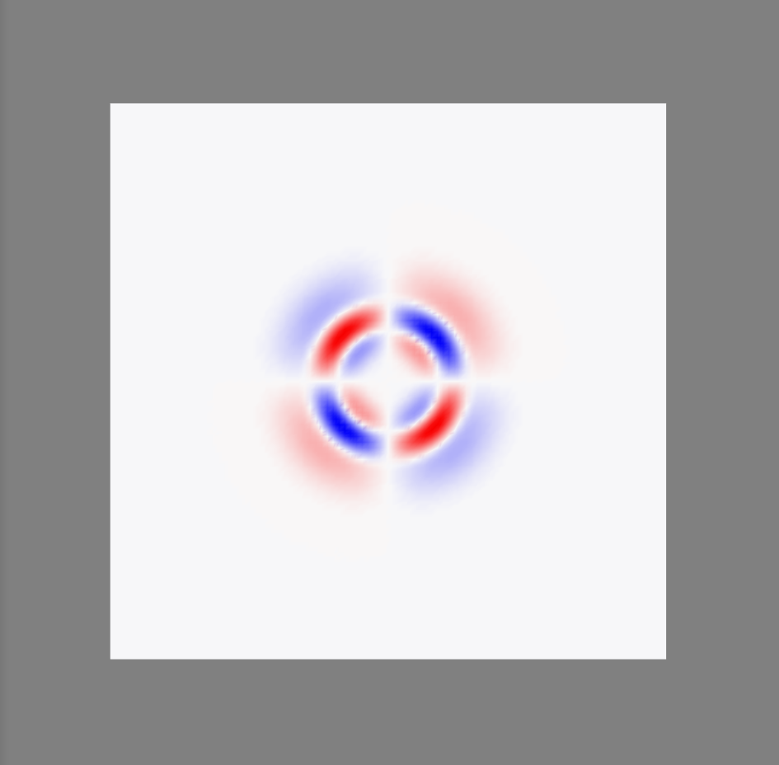

Simulation configuration
Source – DC
ST08
ST02
ST06
ST04
Displacement (z-component)
At source depth

Slide 13
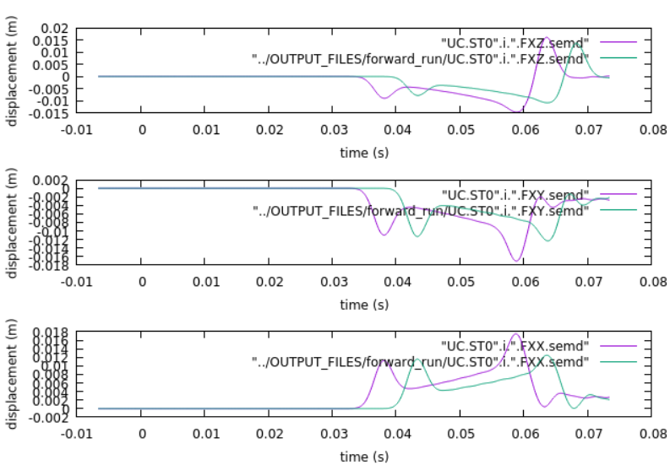
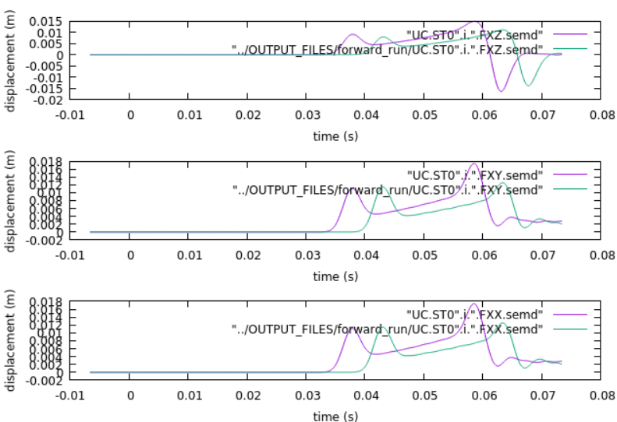
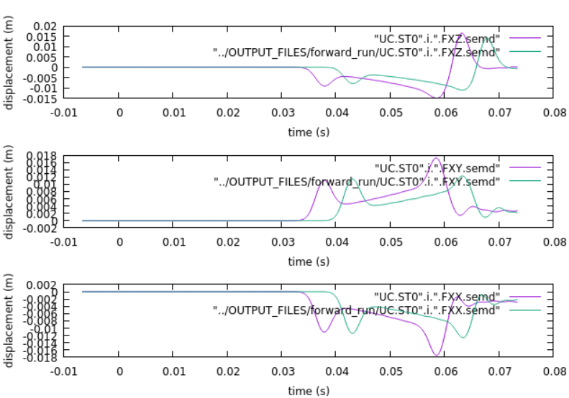
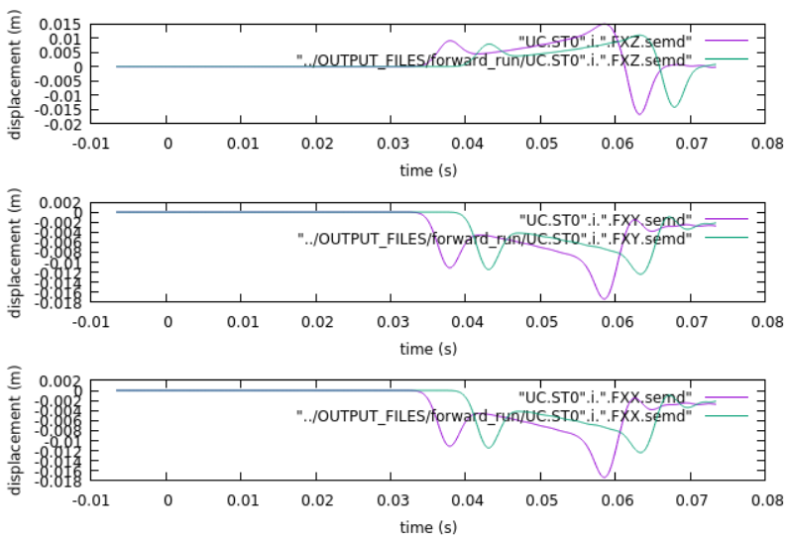
ST08
ST02
ST06
ST04

Slide 14
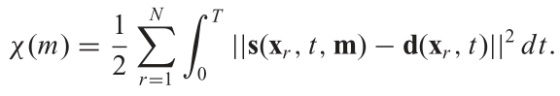
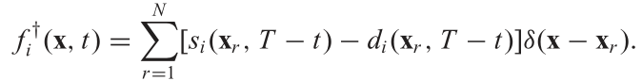
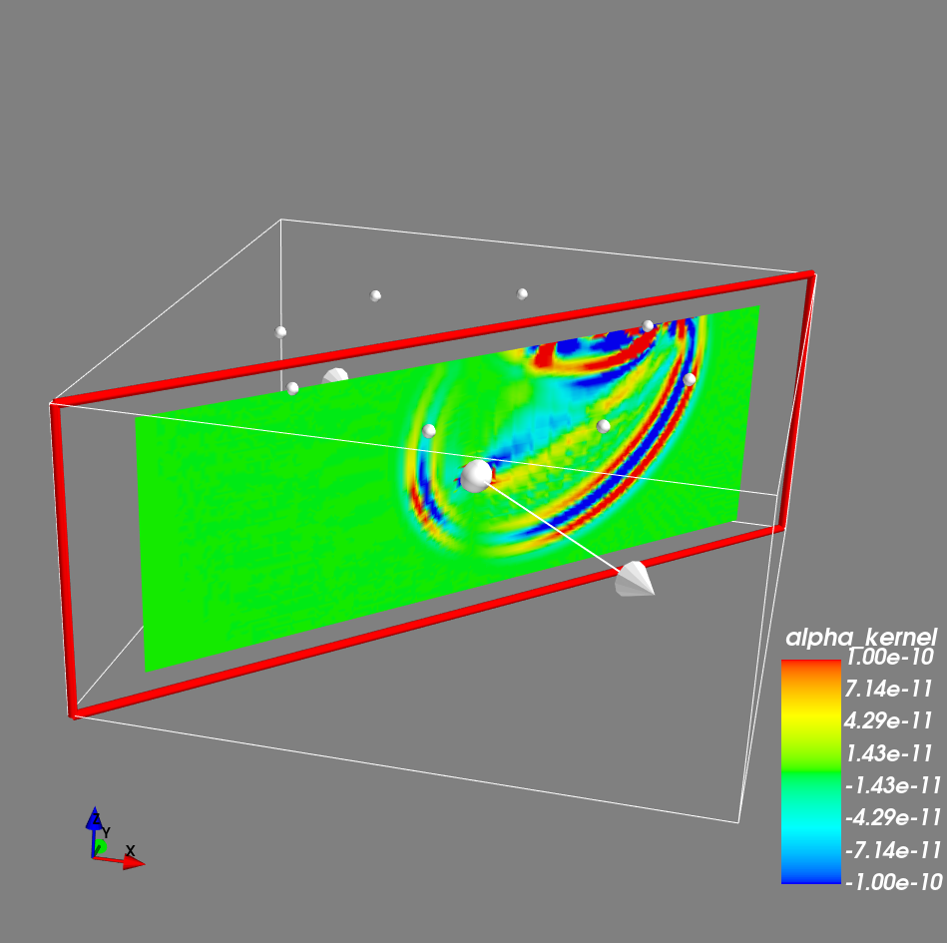
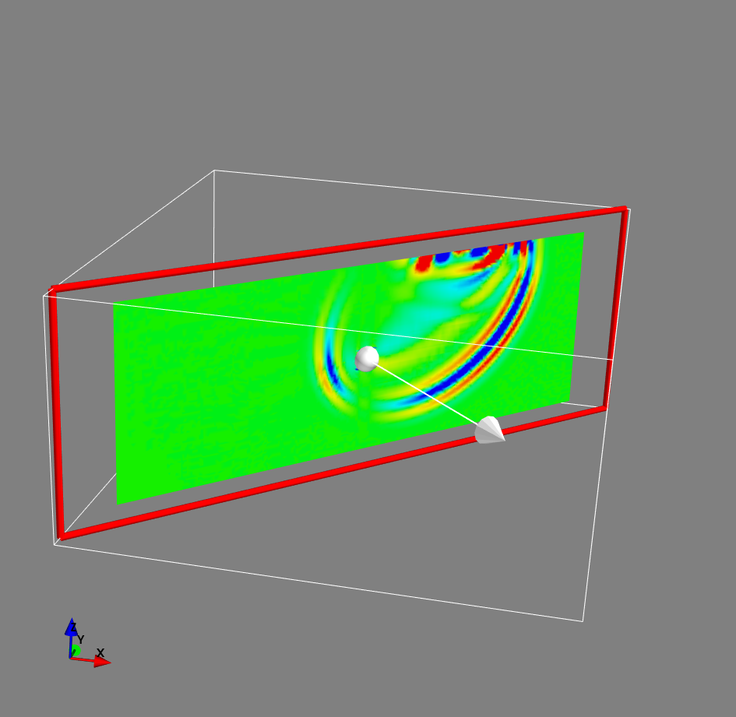
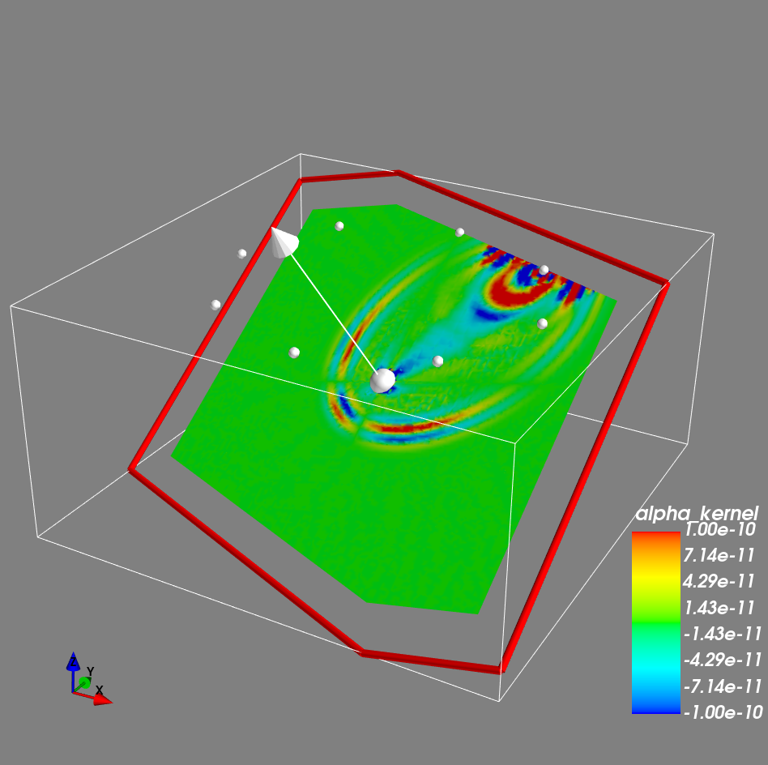
Waveform misfit - derivatives with respect to structural parameter
Synthetic
waveform
Actual waveform
Adjoint source

Slide 15
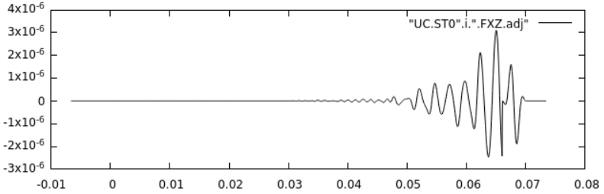
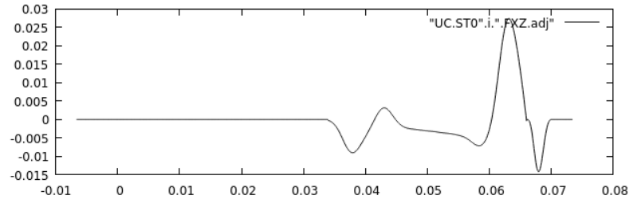

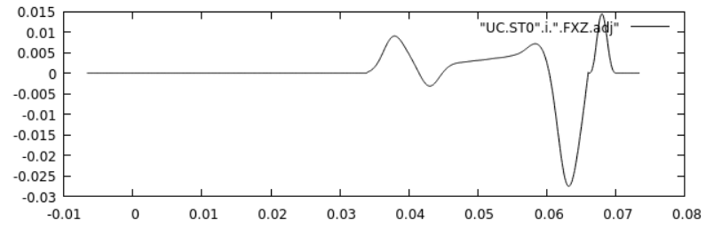
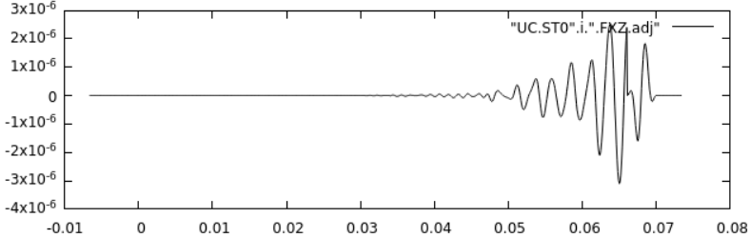
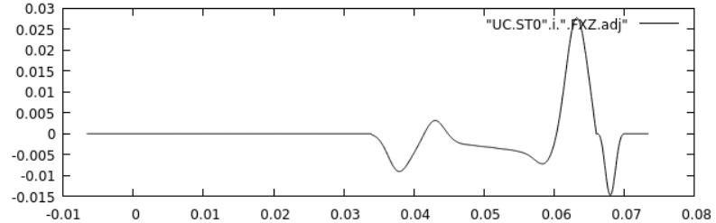
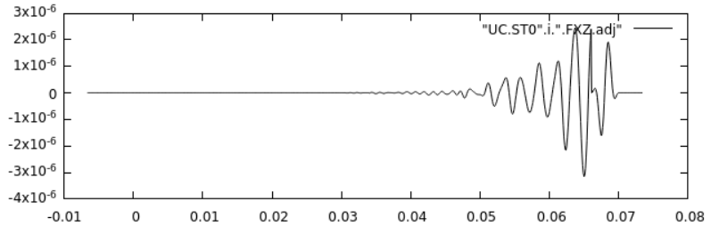
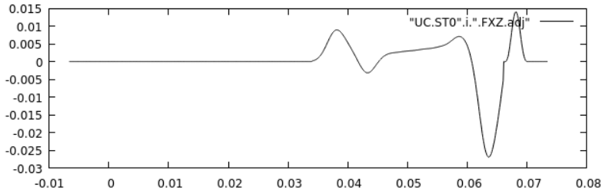

Slide 16
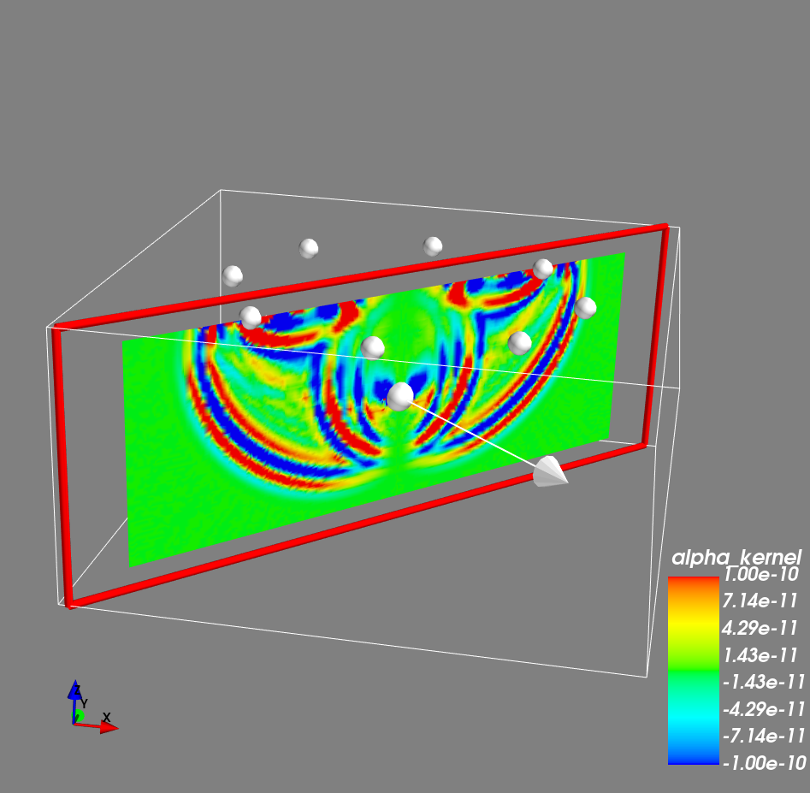
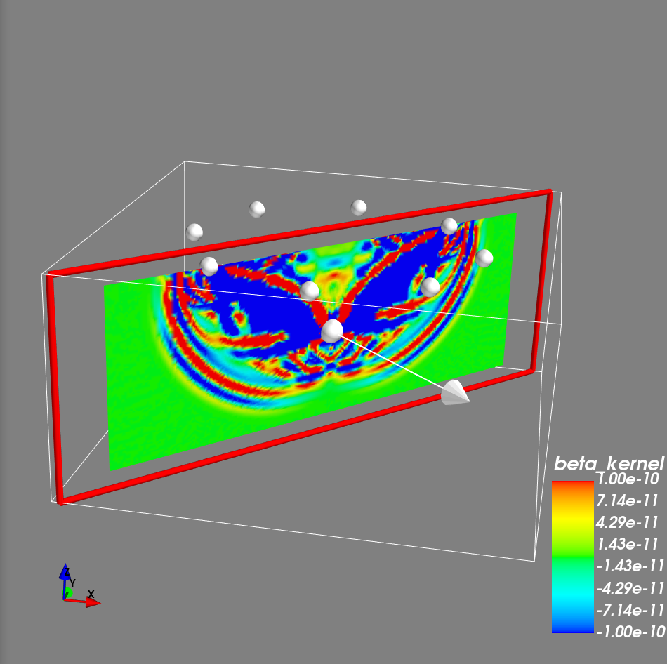
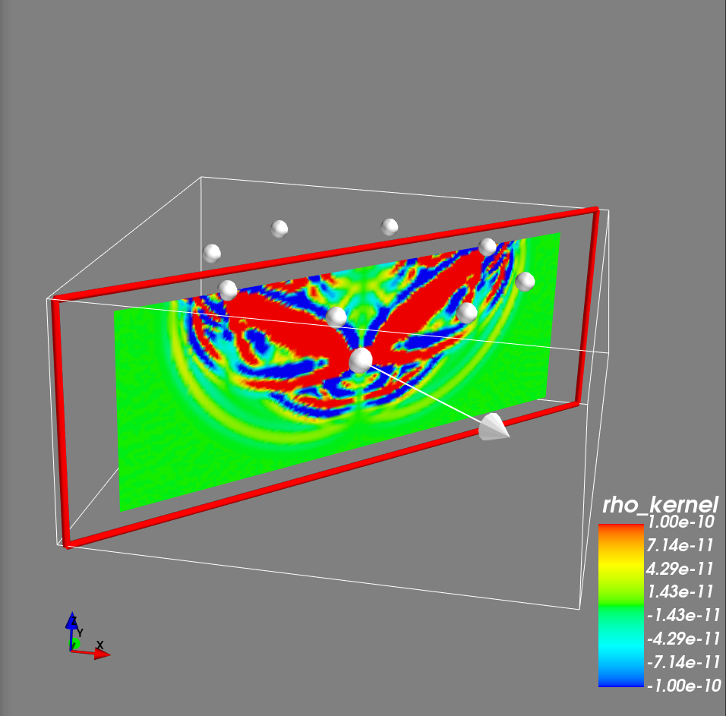
Waveform kernel

Slide 17
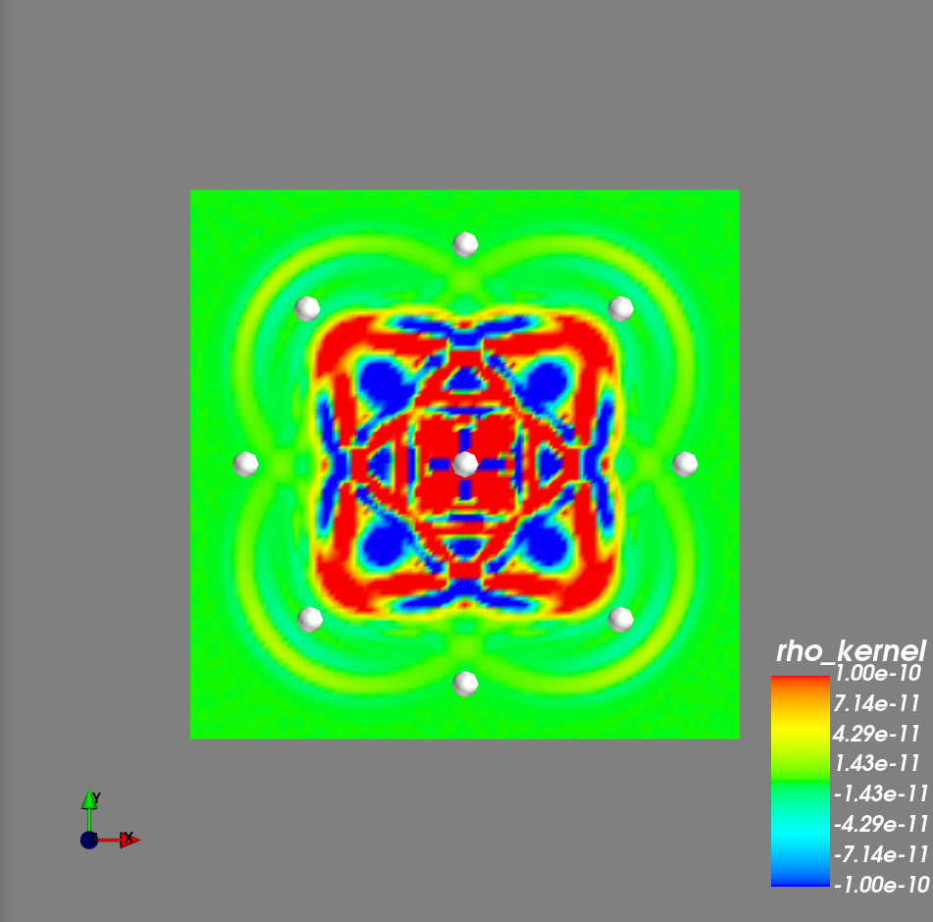
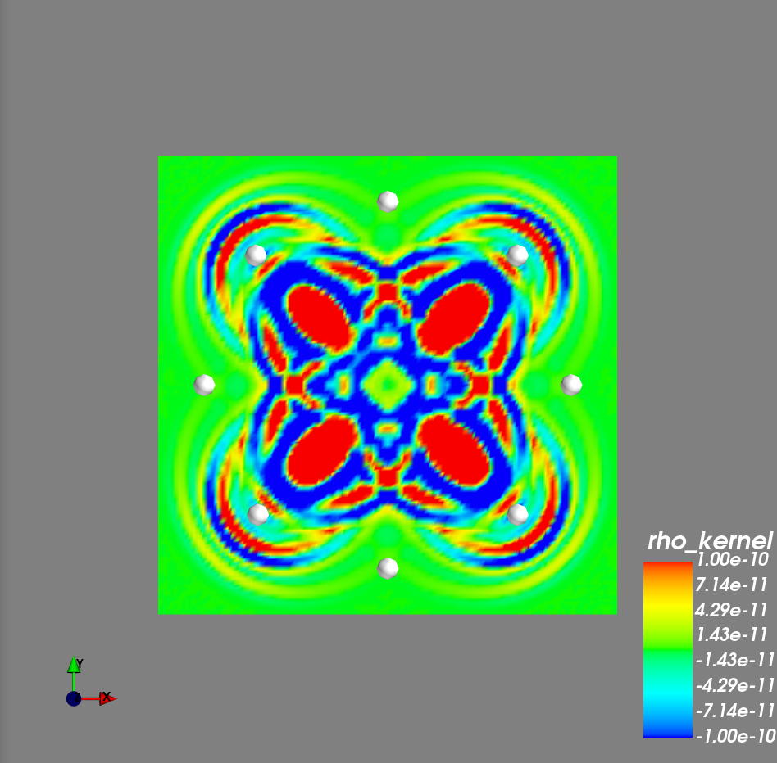
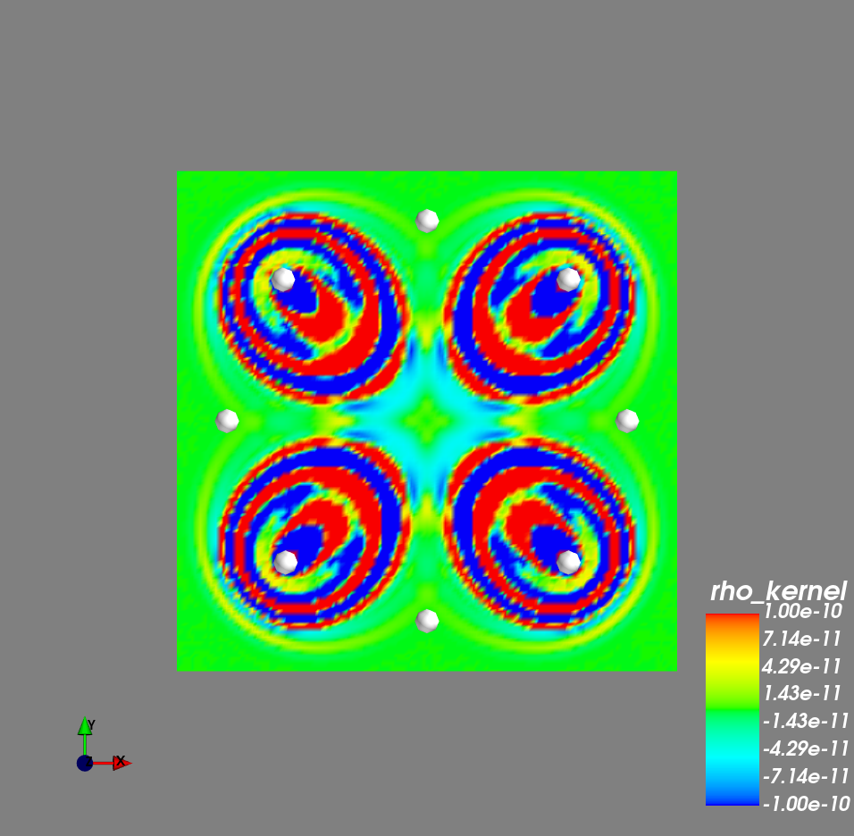
Z = -50

Slide 18
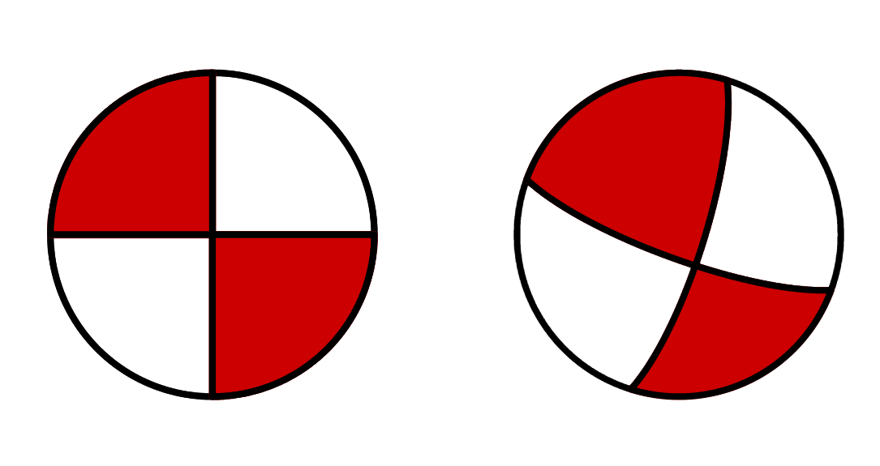
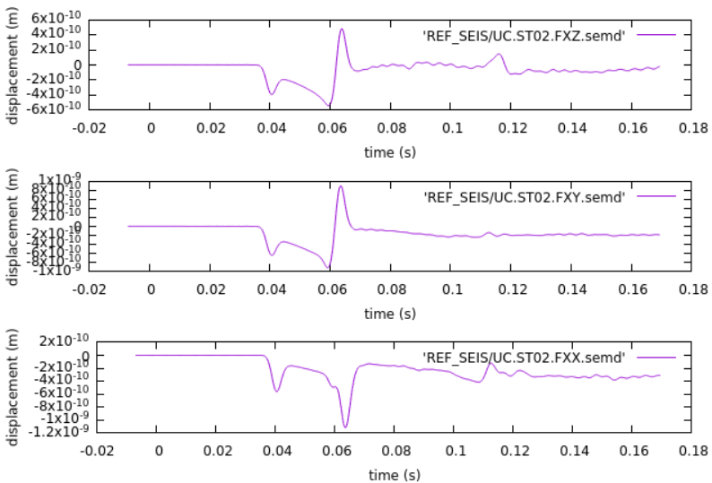


Source Inversion
ST02
ST02
Strike : 110
Dip : 78
Rake : 13 (oblique reverse left-lateral)
Mw : 1.8
Strike : 90
Dip : 90
Rake : 0 (pure strike-slip left lateral)
Mw : 2.0
“True” data
Starting Model
Windowed waveform difference / Misfit (Adjoint source)

Slide 20


Adjoint simulation
Output adjoint simulation :
Strain waveform at source location
Frechet derivative with respect to source parameters (M_ij and x_i)
Coordinate system convention
U (x1)
U (x3)
N (x2)
E (x3)
E (x1)
S (x2)
Global CMT
(Up-South-East)
Specfem3d
(East-North-Up)

Slide 21
Source inversion
Current Velocity model
Forward simulation
Current CMT model
Forward waveform
Update model
M = M – alpha*grad
Model update
(Gradient descent/steepest descent)
Alpha = 1e-41
Forward and Adjoint simulation
Make adjoint source
“True” waveform
Scaling with covariance matrix
Adjoint source
Adjoint simulation
Frechet derivative

Slide 22




scaling

Slide 23
Misfit reduction

Slide 24


Learning rate/step length
Good enough
Learning rate too large

Slide 25
Gradient-based optimization
Adjoint simulation -> tools untuk menghitung gradien dari misfit function
Data
Fungsi misfit
misfit
model
Forward operator
Sintetik
d(misfit)/d(model)
Model update (model + step vector)
Step direction
Step length

Slide 26
Backups

Slide 27





Strain waveform

Slide 28





Adjoint Method philosophy

Slide 29








Slide 30



Z = -25

Slide 31



Z = 0

Slide 32



Traveltime kernel

Slide 33



Traveltime kernel

Slide 34




Slide 35







Movie volume (velocity Z component) slice at y=10 (+=red)
iteration100
iteration200
iteration300
iteration400
Reflected from free surface
iteration500
iteration600
iteration700

Slide 36





Source Inversion (Derivative with respect to source parameters)

Slide 38

Adjoint source
Velocity = homogeneous
Data Moment Tensor = DC
Synthetic Moment Tensor = explosion

Slide 39








Slide 40







Movie volume (velocity Z comp.) slice at z = -50
iteration100
iteration200
iteration300
iteration400
iteration500
iteration600
iteration700

Slide 41




Slide 42





Slide 43

Surface Movie ( Velocity Z component at z=0)

Slide 44



Tomographic model
We can supply tomographic model and assign vp, vs, density value to our mesh
Mesh configuration = mesh simple model
Source type = source type from simple model 2
Density calculated from Gardner’s equation

Slide 45




Movie
receiver
Source

Slide 46


Slide 47


Slide 48




ST01
ST08
ST02
ST07
ST03
ST06
ST04
ST05

Slide 49



ST08
ST02
ST06
ST04

Slide 50
ST08
ST02
ST06
ST04

Slide 51


Slide 52


